Slide 1


Student Management System
Under The
University of Calcutta
Developed by
Under the supervision of Monali Poddar Assistant Professor and Head Department of Computer Science Maharaja Manindra Chandra College ,University of Calcutta ,Kolkata, West Bengal, India 2022
Arnab Manna Roll No.: 193211-21-0030 Reg. No: 211-1111-0353-19
Kunal Pal Roll No.: 193211-21-0027 Reg. No: 211-1111-0347-19
Niketan Pal Roll No.: 193211-21-0042 Reg. No: 211-1114-0335-19
Akash Yadav Roll No.: 193211-21-0037 Reg. No: 211-1111-0362-19

Slide 2



INTRODUCTION
A Student Management System is a software that manages the students records of an institution , thus helping in maintaining the data in a efficient way and extract meaningful information form that data.
An Administrator can login into the system and perform any of the available operations,
Can edit student information to the database.
Can make search for a specific student.
Can access all the details of the student
A Student can login into the system and perform any of the available operations,
Can check their details
Pay their fees
Product Function:

Slide 3

Motivation :
To meet a solution , that provides an effective way to manage students records for , small institutes and , Edu-tech startups , large and medium scale tutions, small schools .
To overcome existing problems faced , in manual record handelling and maintainance .

Slide 4
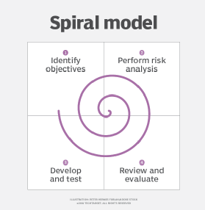
Software Development Model
Spiral Model
We have used the spiral model for its , effectiveness , as expertise was less and the project requirements are subject to change as per customer requirements , we decided to follow the spiral model of development .
Instead of customer feedback we used team feedback , after completion of each release and gradually the software came into form,
For this quick development we used python and in the Web front we used JSP technology as JVM is very reliable .

Slide 5
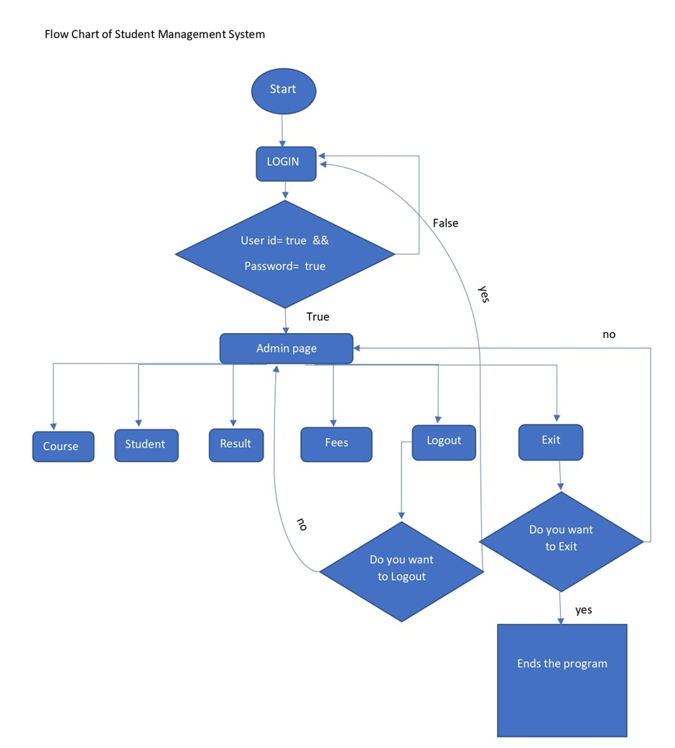
Admin side flow chart
Login systems
And other
Sub-systems

Slide 6
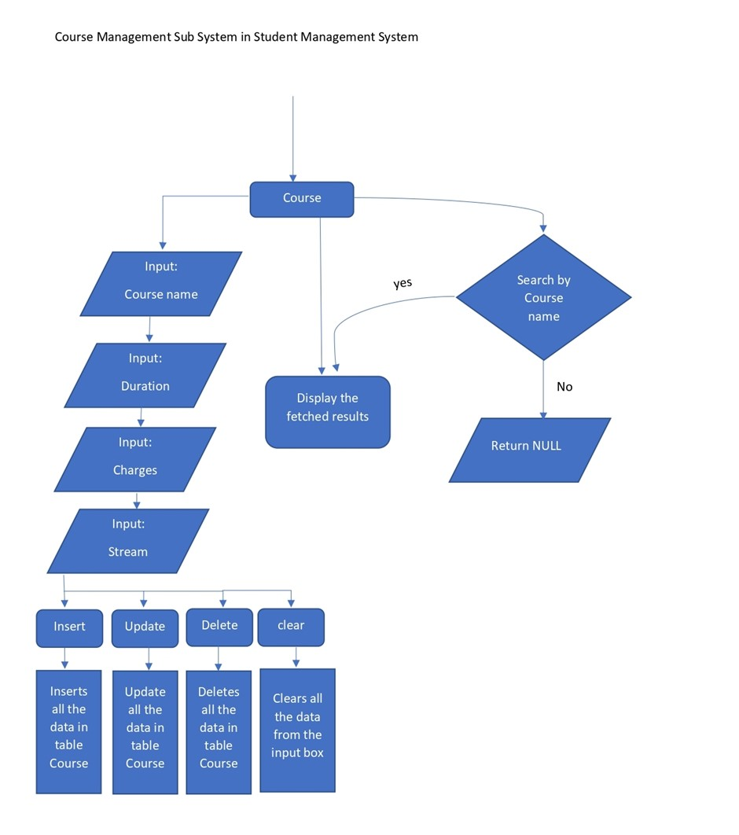
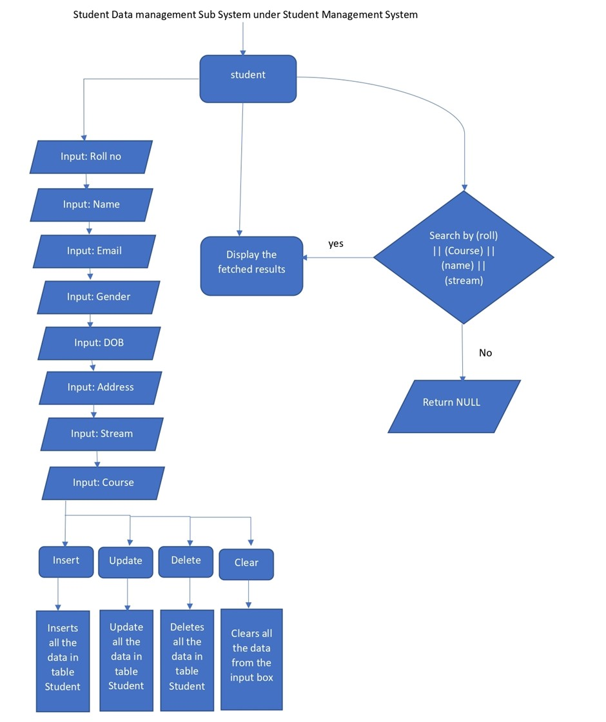
Student details
management system
Course management system

Slide 7
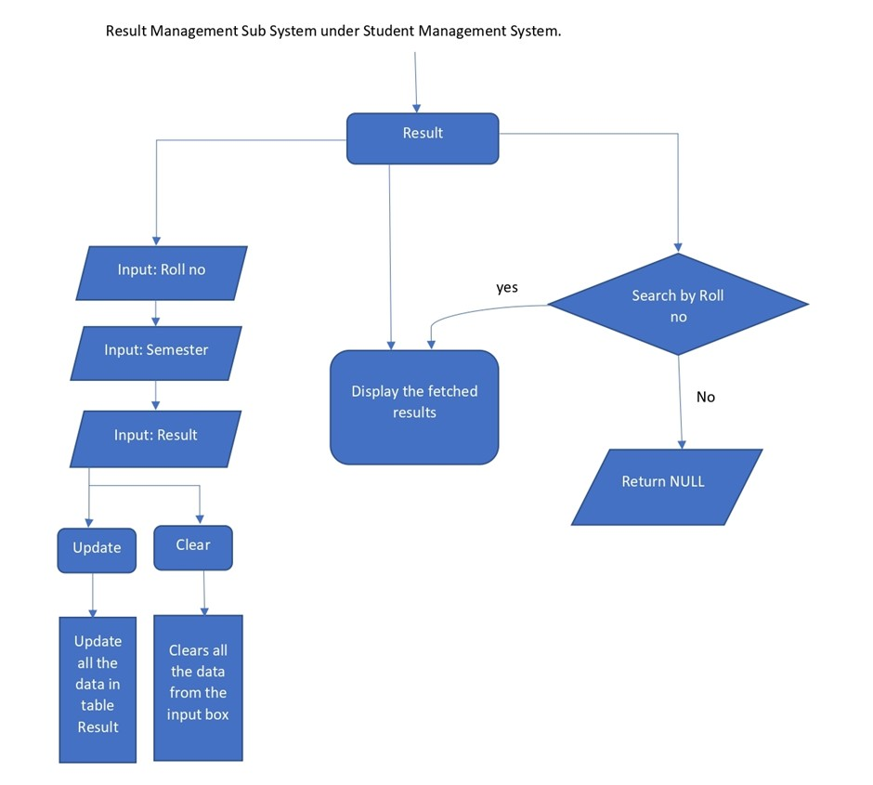
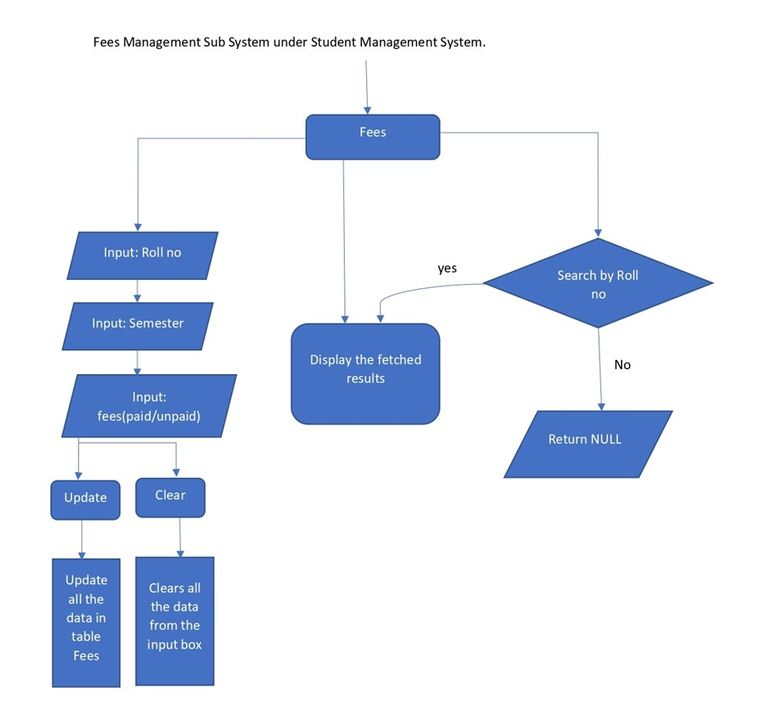
Results
Management System
Fees
Management System

Slide 8
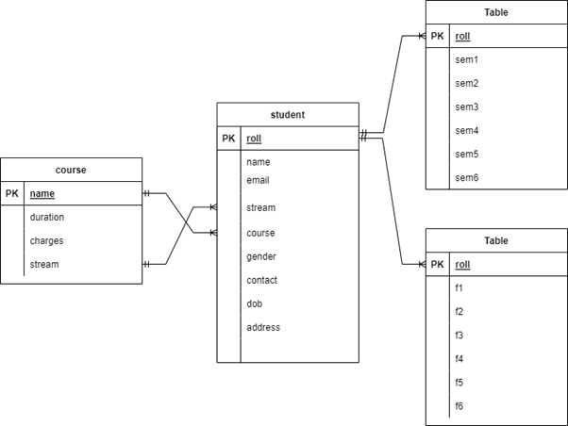
Data Base MySQL
ER Diagram
The Entity Relationship Diagram is used to define the workflow of a Data Base ,
Course table
Student table
Result table
Fees table

Slide 9

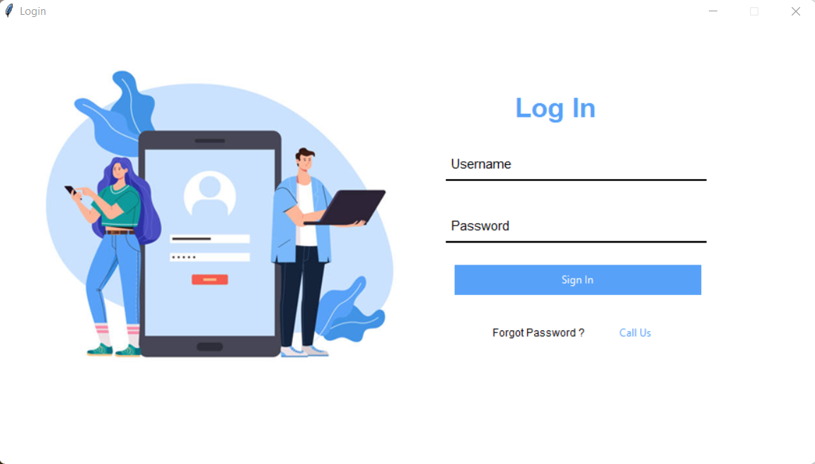
Admin Side Software
Login page
Python is used in this project for the admin side
Work . Libraries used are
Tkinter
PyMysql
Pillow
os
Python was used to for quick development and deployment of the project

Slide 10
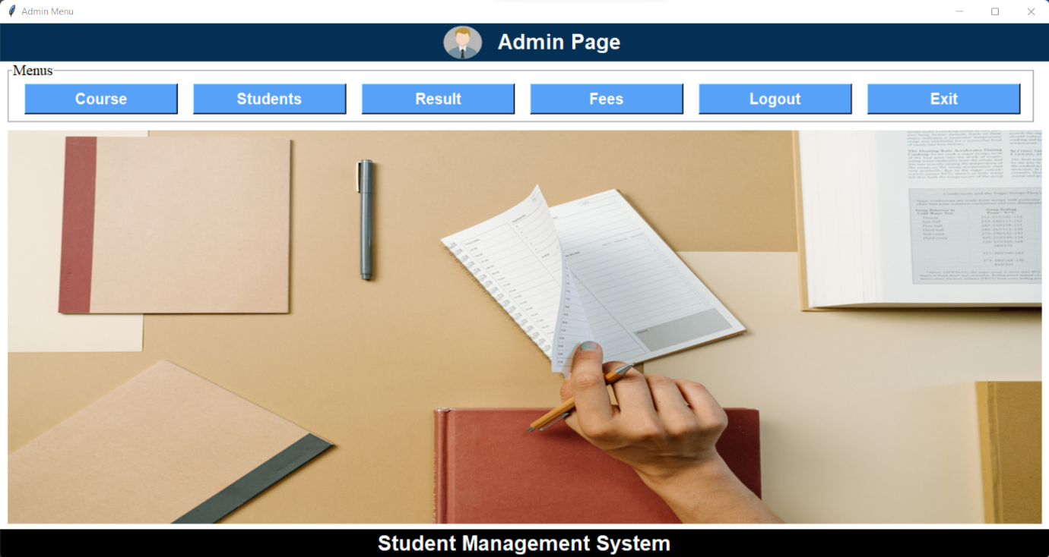
Admin page
Admin has full control over the students details
Admin can perform CRUD operations on students data

Slide 11
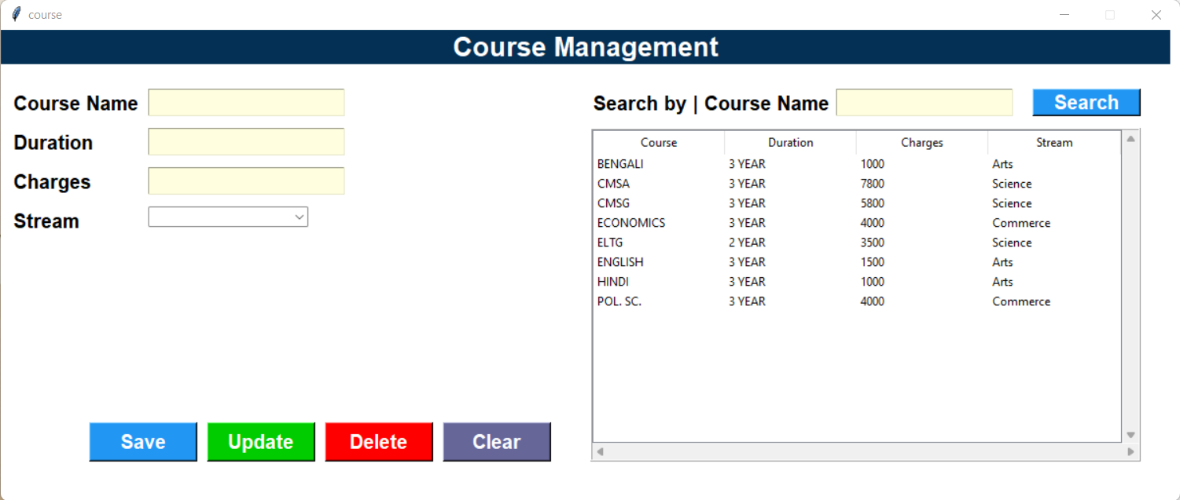
course page
CRUD operations on courses can be performed

Slide 12
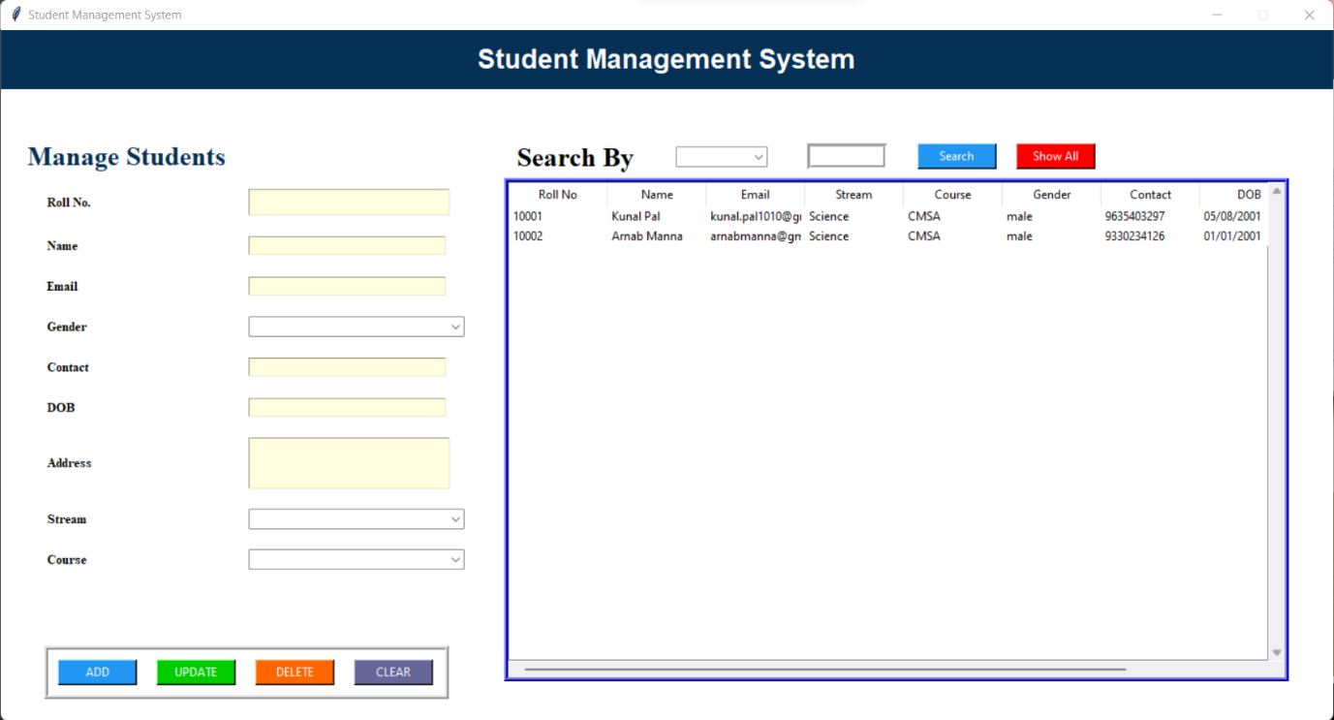
Student page
CRUD operations on Student data can be performed

Slide 13
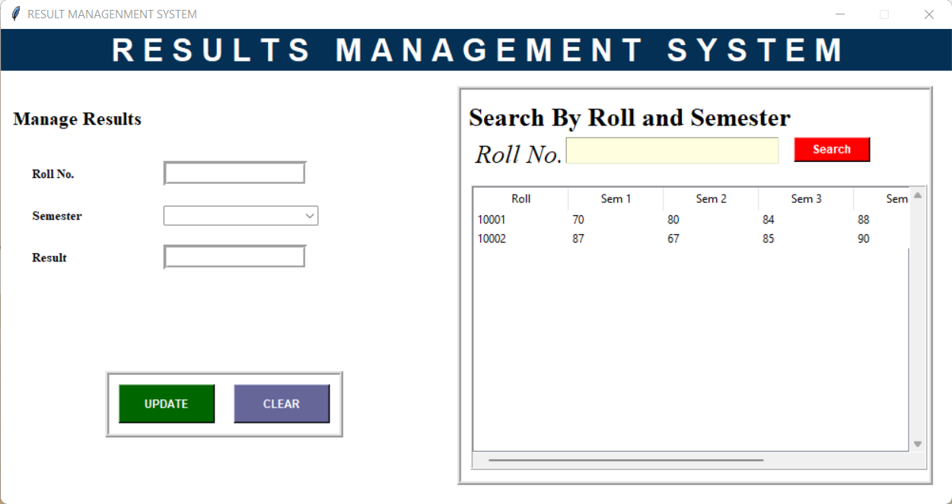
Result page
CRUD operations on Students results can be performed

Slide 14

Fees page
CRUD operations on Students Fees can be performed

Slide 15

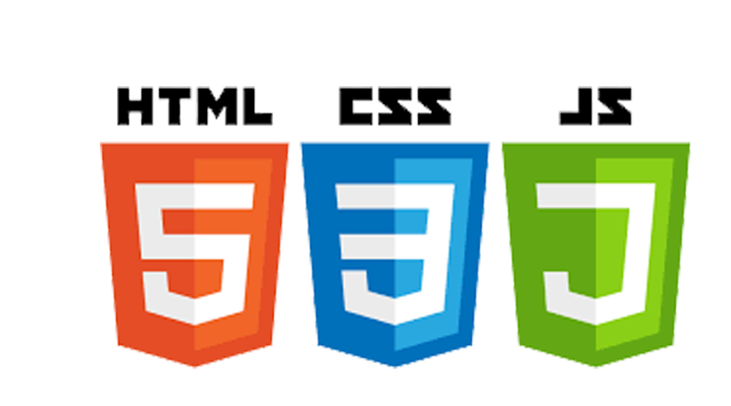
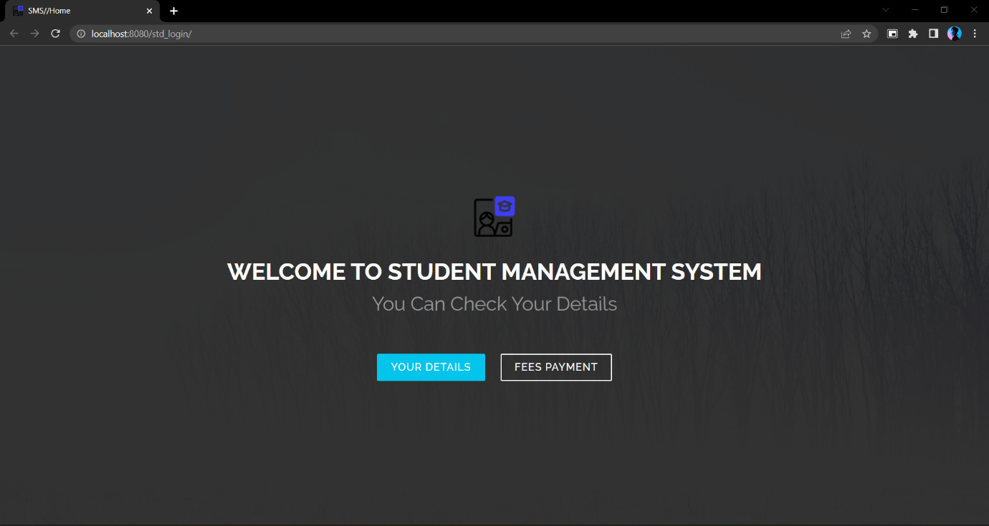
Student Side Software
Home page
Java is used in this project for the Student side
Work . Because it’s a web based system, for students to see their details,
JSP technology was used
JS
CSS
Html
Jdbc
JDK provide a rock solid support

Slide 16
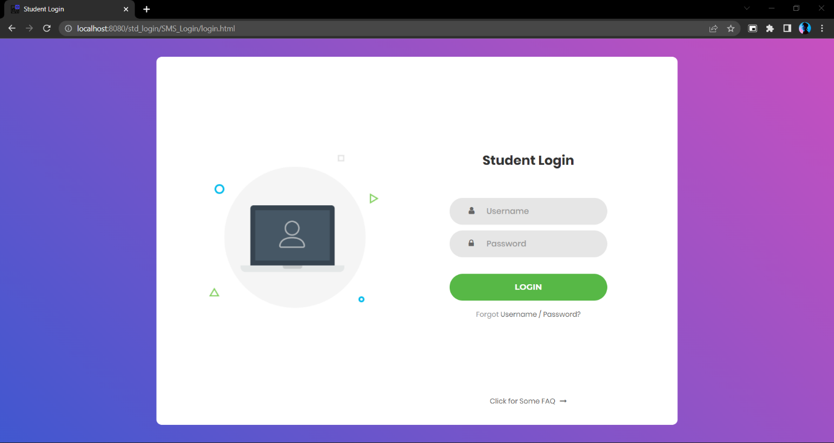
login page
Students login.
Username should be “email/roll”.
Password should be phone number.

Slide 17
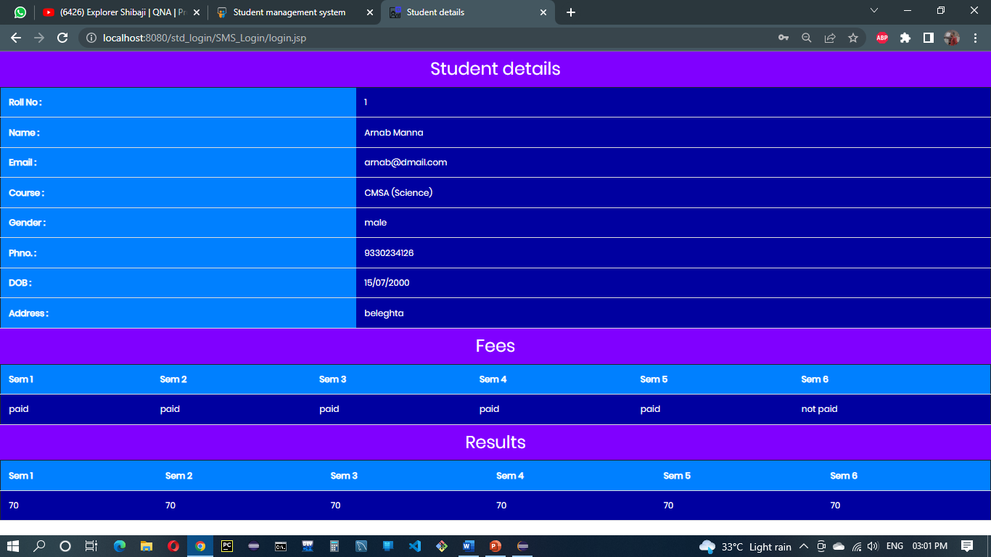
about page
Students information is available when the student successfully login.

Slide 18
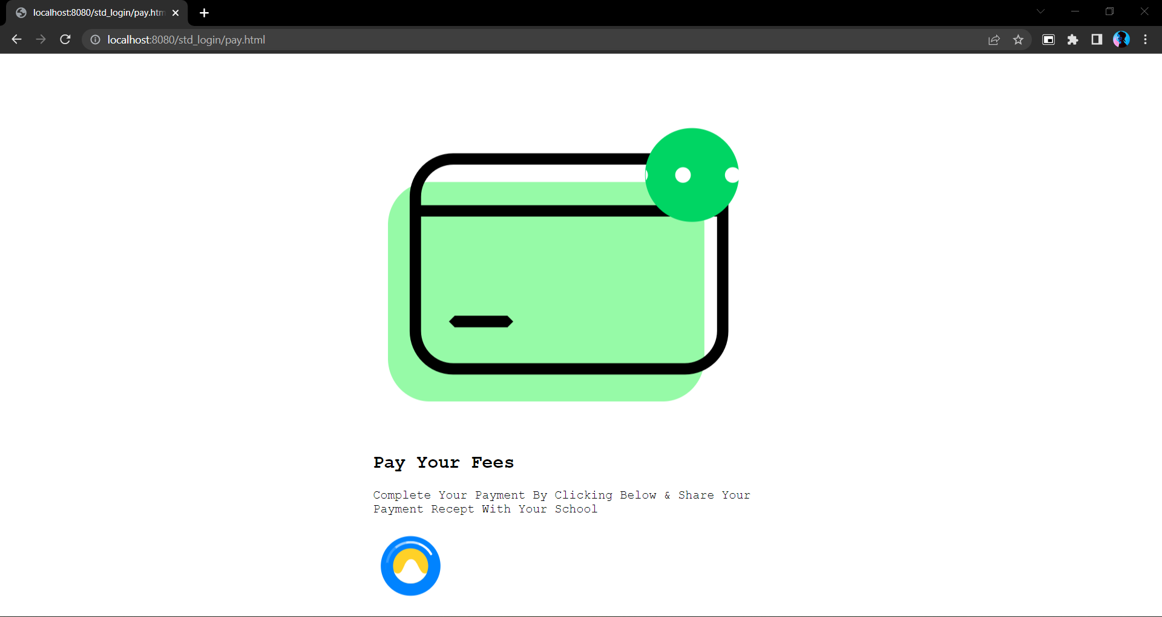
payment page
Students can pay fees online,
A payment gateway or upi gateway will be added in future ,

Slide 19
Conclusion
The results obtained from the experiments and testing ensures that the proposed method is efficient and user-friendly. As compared to existing methods of managing the academic institutions, this project which yields centralized software makes the work administration and management easier and provides detailed information about the topic of user’s interest in just one mouse click.

Slide 20
Future Scope
The Student Management System (SMS) can be enhanced to include some other functionality like online sick leave approve, attendance management.
Talent management of students based on their performance evaluation can be added.
Social networking can also be added wherein students can interact with each other.
Online class functionality can be added.
Can evolve as an online institution.
Functionality of chat and messages can be added.
Online exam functionality can be added.
Online resume builder functionality can also be added.

Slide 21
Bibliography
Books:
Modern Tkinter for Busy Python Developers (by Mark Roseman)
Tkinter GUI Programming by Example (by David Love)
HTML & CSS: Design and Build Web Sites (by Jon Duckett)
You Don't Know JS: Scope & Closures (by Kyle Simpson)
Websites:
https://www.google.co.in/
https://en.wikipedia.org/
https://www.javatpoint.com/python-tkinter
https://lottiefiles.com/
https://www.geeksforgeeks.org/python-programming-language/
https://jrsoftware.org/isdl.php
https://animate.style/

Slide 22
The End
Thankyou

